Slide 1
Using ReconRunner
A Brief User’s Manual
Eddie Yasi | April 19th 2007

Slide 2
Setting Up ReconRunner
Get a copy of RRSetup.exe and copy it to your PC
Double-click RRSetup.exe to install ReconRunner
Make note of what directory you install it in. The default is C:\Program Files\Pioneer\ReconRunner
  You will need to know this in order to add new queries for use in recon reports.
  You may also want to create a desktop shortcut for ReconRunner.exe
NOTE: This is beta software that has not gone through a full production cycle. Use it as an assistant to your normal recon process. Do NOT assume it will correctly catch all issues
ReconRunner is a .Net Forms Application
Using ReconRunner | April 2007 | Page <number>

Slide 3
Setting Up ReconRunner
ReconRunner will install with a few sample recon reports ready to go. The sample reports run some comparison queries between MARS and EIM.
If you want to try these sample reports, you will need connection information added to your PC’s MACHINE.CONFIG file for MARS and EIM. Note that any databases you will want to run recon queries against will also need to have their configuration information added to MACHINE.CONFIG as well.
To run it, double click ReconRunner.exe, or a shortcut that you’ve created.
Sample Reports
Using ReconRunner | April 2007 | Page <number>

Slide 4
ReconRunner Basic Concepts
What it does / What files it uses
ReconRunner is designed to take data from two queries, identify related records in each, and then report any data differences found between the two. The queries may run against the same or different databases.
One or more recon reports may be run together, and for each set of reports run, ReconRunner will create an Excel spreadsheet with the results. Each report run will have its own tab in the spreadsheet created.
Each report will have 3 sections:
  First Query Orphans: This will show records found in the first query that had no matching records in the second query.
  Second Query Orphans: As above, but shows orphan rows in the second query.
  Data Differences: For rows that it was able to match between the two queries, it will show one row for each data item found that differed between the two queries. (The user is able to limit which columns are actually compared.)
SQL Queries to be used by recon reports are kept in the ReconRunner config file.
Recon reports are defined in a recon report xml file created by the user. The user may author as many recon report files as needed, and each report file can run one or more recons at the same time.
Using ReconRunner | April 2007 | Page <number>

Slide 5
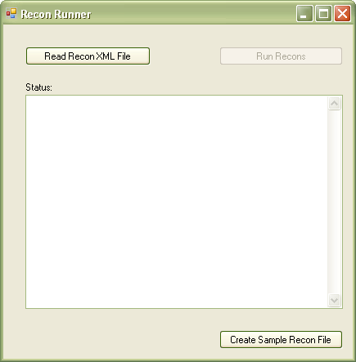
Running Recon Reports
Using ReconRunner to run a Recon Report XML file
Click ‘Read Recon XML File’ and select the set of Recon Reports that you wish to run.
Verify that no errors occurred by checking status messages.
  If one or more errors occur, you either didn’t point to the proper file, or your ReconReport XML file has an error.
Click the Run Recons button to being running the reports. You will be prompted to show where the resulting Excel spreadsheet should be saved, and what it should be called.
Depending on how many reports you have in your file, this may take awhile. No status will be given other than a message at the end.
Check the Status area again to see if any reports had any errors. The most likely cause of errors is one or both of the databases was unreachable, or there is a problem with one or both SQL statements (such as identifying columns not sufficient to guarantee uniqueness, etc.)
Even if one or more reports had an issue, your Recon Report spreadsheet should be created, with each report successfully run having a tabbed worksheet with the results.
Using ReconRunner | April 2007 | Page <number>

Slide 6
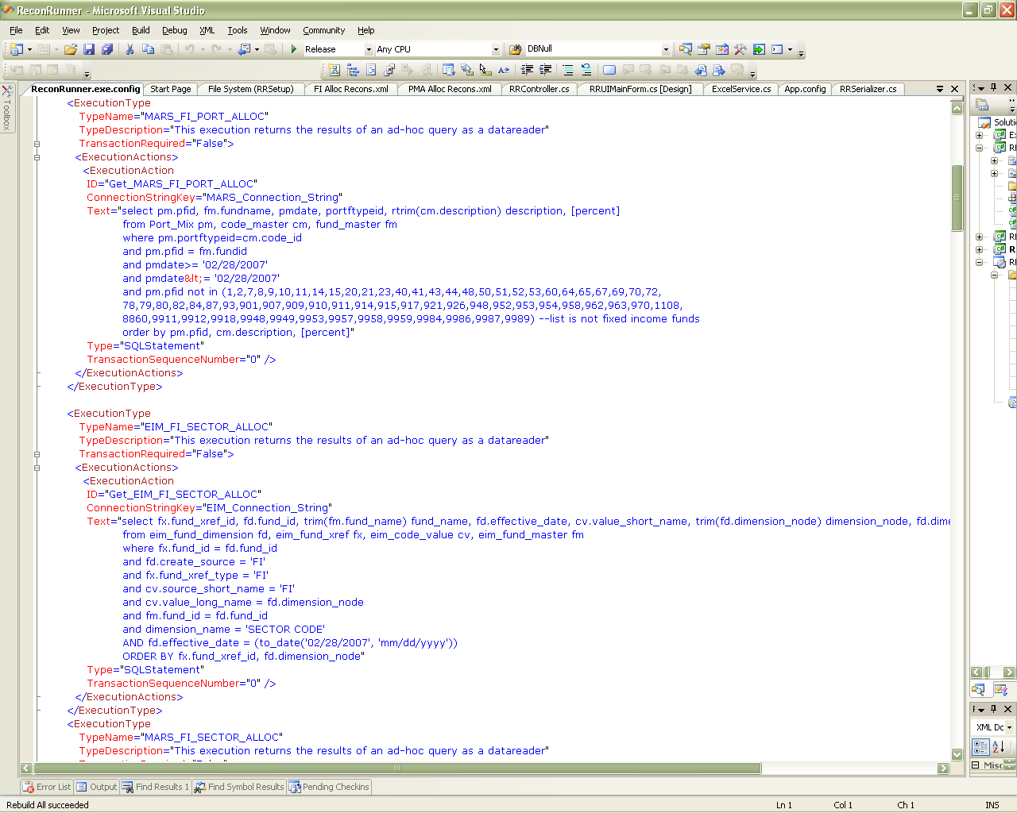
Configuring Recon Reports
Creating SQL Statements to be used as queries in Recon Reports
SQL Statements are placed in the ReconRunner.Exe.Config file, found in the directory in which you installed ReconRunner
Each SQL Statement is placed within an <ExecutionType> tag. The easiest thing to do is copy a pre-existing entry, and then modify it.
There are three things you should then change:
You should change the TypeName and ID to something meaningful for the query. (You’ll use the TypeName value in your recon xml file later.)
The ConnectionStringKey should be set to point to the appropriate database, and must refer to an entry in your MACHINE.CONFIG file.
The actual text of the SQL statement to be executed goes in the Text attribute.
Each recon needs two queries to compare. It’s recommended that you name them similarly so the relationship is obvious.
Using ReconRunner | April 2007 | Page <number>

Slide 7
Writing Queries for ReconRunner
Preparing to create your Recon Report XML file from your queries:
For each recon you must have one or more columns that can be used to identify related records in the two queries to be compared. These columns must uniquely identify each row in each query. In other words, no two rows within each query should have the same set of values in their identifying columns. If you do have a query with more than one row having the same set of values in their identifying columns, then you must modify your query and/or have more identifying columns in order to prevent this. (IdentifyingColumn = true in recon xml)
ReconRunner will know what pairs of records to compare by finding rows in the two queries that have the same values in all their identifying columns.
You must also decide which columns are to be compared between the two queries. When two records are being compared, ReconRunner will only report a row if one or more of these columns have different values. (ShouldMatch = true in recon xml)
You must identify every column as either ‘number’, ‘text’, or ‘date’. ReconRunner can not work with BLOBs, CLOBs, etc. ReconRunner will attempt to parse columns appropriately, so even if a column is natively stored as text in the database, if you identify it as ‘number’ or ‘date’, ReconRunner will try to convert it. If a conversion fails on a column being matched, the row will be reported.
You may also want some columns to appear in any reported rows for ease of reference, even if these columns aren’t identifying or matching columns; e.g. Fund Name or other columns that will help research any issues found. (AlwaysDisplay = true in recon xml.)
You should make sure any SQL statements created perform adequately before using them. Although you put all your queries in one config file, you can have as many recon report XML files as you need, and if you do have some demanding queries, you should consider placing them in their own XML files which may be run after regular work hours.
Test each query you author in an appropriate tool (SQL Developer, Toad, SQL Server Management Studio, etc.) first to be sure it runs without error and does not take an excessively long time to run.
Using ReconRunner | April 2007 | Page <number>

Slide 8
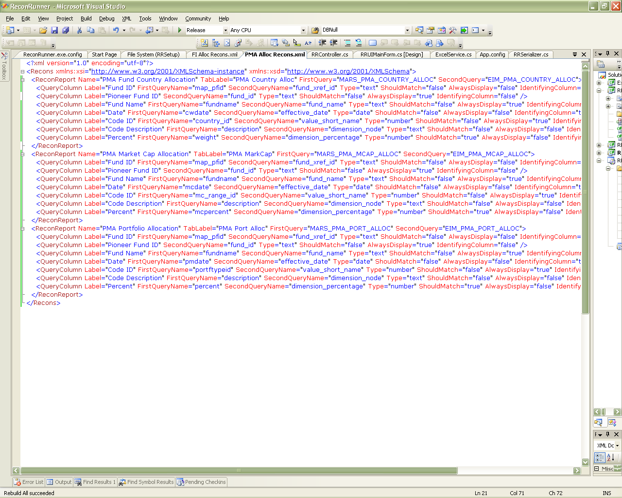
Creating a Recon Report XML File
The <Recons> and <ReconReport> Tags
If you don’t have a sample file available, you can click the Create Sample Recon File button on ReconRunner, or review the one below. You may use any text editor to author your Recon Report XML files.
Each recon report XML file has a root <Recons> tag that contains all the recon reports to be run. Each report to be run is represented by a <ReconReport> tag containing several <QueryColumn> tags.
Each <ReconReport> tag must have all of the following attributes:
Label: What title to give it in the spreadsheet
TabLabel: What text to put on its worksheet tab in the spreadsheet created. (This should usually be kept to 20 characters or fewer)
FirstQuery: The TypeName of the query defined in the config file that you want to use as your first query in the recon.
SecondQuery: The TypeName of the query in the config file you’ll use as your second query in the recon.
If you have one report experiencing problems in an XML file, and other reports are working well, you can temporarily comment out the problem report by placing <!- - before its <ReconReport> tag and - -> after the </ReconReport> tag. (No space between the dashes). It will be skipped in future runs until you have resolved the issue and removed the comment characters.
Using ReconRunner | April 2007 | Page <number>

Slide 9
Creating a Recon Report XML File
The <QueryColumn> Tag: 1 of 2
Each <QueryColumn> provides information on each column that ReconRunner needs to be aware of. There may be additional columns in either query for other purposes, but if they don’t have a <QueryColumn> entry they will be ignored.
Each <QueryColumn> tag needs the following attributes:
Label: This will be used as a column header in the report worksheet.
FirstQueryName: This is the name of the row element in the first query that corresponds to this column. If there is none (for example, if the column is a reference column that only exists in the second query, then this attribute should be omitted entirely. See Pioneer Fund ID in the example to the right.)
SecondQueryName: As above, but for the second query. Also optional if the column is not found in the second query.
Type: Set to “text”, “number”, or “date”. This only matters for columns that will be matched, but should be provided for all.
Using ReconRunner | April 2007 | Page <number>

Slide 10
Creating a Recon Report XML File
The <QueryColumn> Tag: 2 of 2
The following attributes are important in determining how ReconRunner will treat each column. Each one should be set to “true” or “false”:
IdentifyingColumn: Any column marked as an IdentifyingColumn will be used to match up rows in the two queries for comparison. Identifying columns will always be listed in any rows reported.
ShouldMatch: Any column marked as ShouldMatch will be compared between matching query rows, and any differences will be reported.
AlwaysDisplay: Any AlwaysDisplay columns will be listed on each row reported, but are NOT compared between matching rows, and are NOT involved in identifying each row for matching purposes. These are the only columns that may exist on only one of the two queries. (i.e. you may omit EITHER FirstQueryName or SecondQueryName if you want)
Note: in general only ONE of these three attributes should be true for any particular column. The only possible exception is if you have a ShouldMatch column that you always want displayed even when another column has a data difference that is being reported. In this case both ShouldMatch and AlwaysDisplay could be set to true.
Using ReconRunner | April 2007 | Page <number>

Slide 11
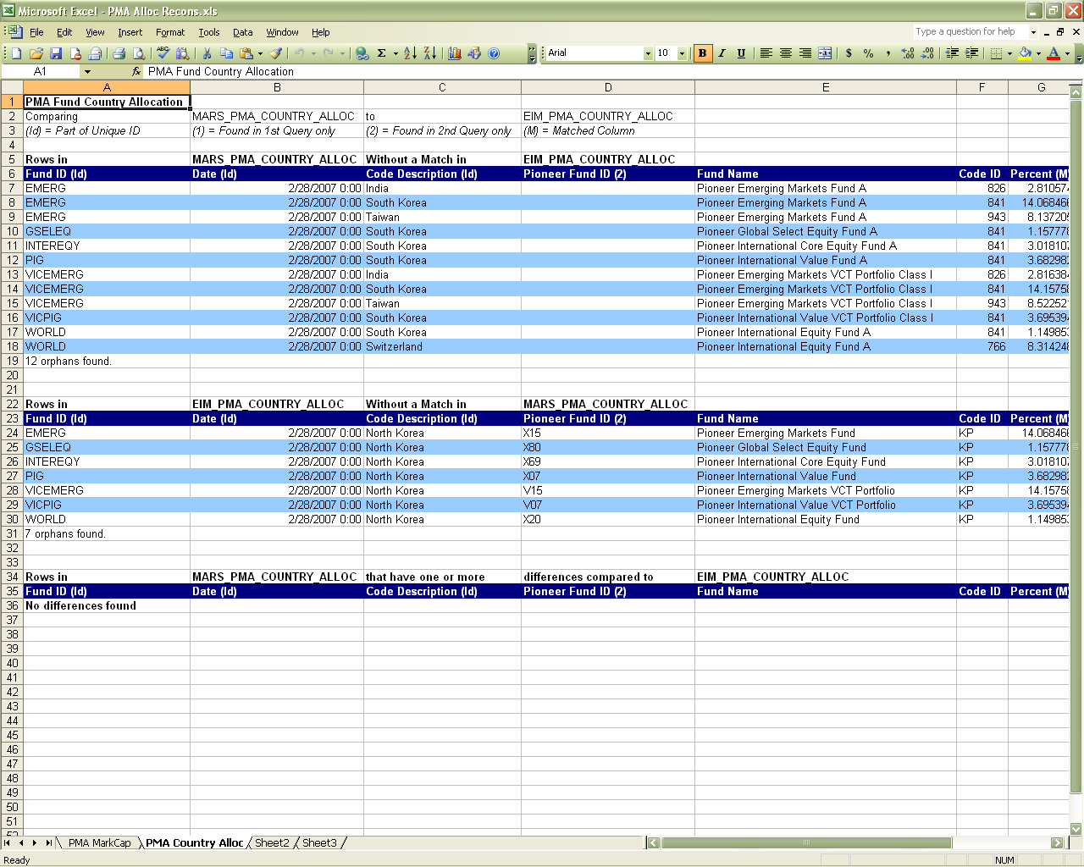
Recon Report Format
Layout for Each Worksheet Created
Each report will have three sections:
The first section will show “orphan” rows in the first query that don’t have any matching row in the second query.
The second section will show rows in the second query that are “orphans” without a corresponding row in the first query.
The final section will show any differences that were found in ShouldMatch columns between rows in the two queries that have been matched up. Each difference found will have its own row, so there may be more than one entry per matched pair of records if more than one ShouldMatch column differs.
Note that each column header will also indicate what columns were used as Id columns (Id), what columns are only found in the first query (1), or what columns are only found in the second query (2).
Columns will be ordered from left-to-right by showing Id columns first, then AlwaysDisplay columns, and then finally the ShouldMatch columns. Within each of those sets of columns, the order they appear in the recon report’s XML file will be determined by the order they’re shown on the final report.
Using ReconRunner | April 2007 | Page <number>

Slide 12
Further Help
If there is a problem
See the DBAs for information on username/password for connecting to a particular database. Let them know you want a ‘read-only’ account if one exists.
Always back up your ReconRunner.exe.config file before modifying it.
If you are going to edit an existing ReconReport XML file, make a copy first.
See Eddie Yasi (x4595) if you need further assistance.
Reminder: This is essentially a ‘beta’, so use it as an adjunct to your reconciliation process, and be sure to spot-check for accuracy if you are going to rely on it to any extent.
Using ReconRunner | April 2007 | Page <number>

